Slide 1

Exploratory Data Analysis
G2M Insight for Cab Investment
July 2022

Slide 2

Executive Summary
Problem Statement
Approach
EDA
Summary & Recommendation

Slide 3
Executive Summary
XYZ is a private firm residing in the US. Due to the remarkable developments in the transportation sector in the last few years, the company has decided to invest in the transportation sector.
Objective: Provide actionable insights to help XYZ firm in identifying the right company for making investment.
This analysis has been divided into three parts:
Understanding the datasets.
Finding the most profitable Cab company
Recommendations for investment

Slide 4
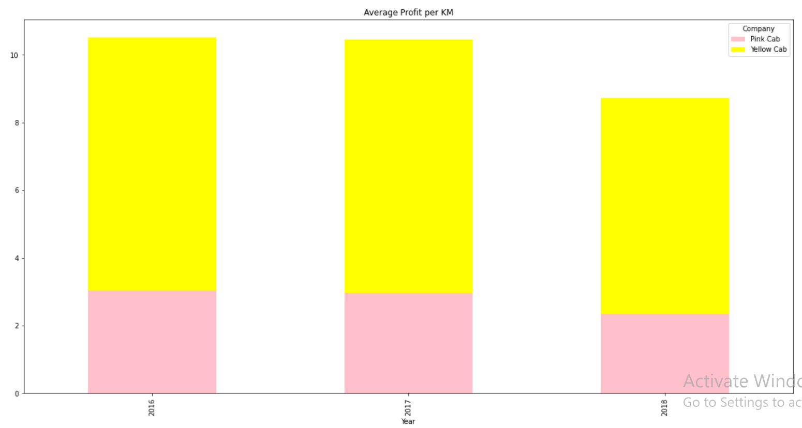
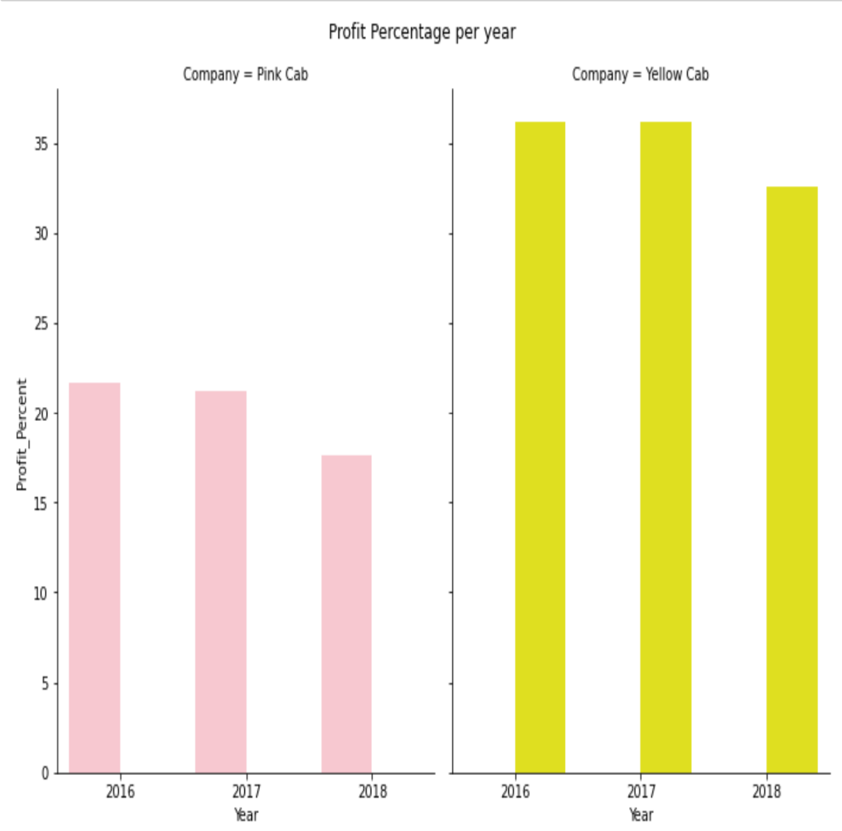
Profit Analysis
The Profit Percentage per year chart shows the Yellow Cab company earns more than the Pink Cab company
The Average Profit per year shows that there’s a huge profit margin per Kilometer between the 2 companies.

Slide 5
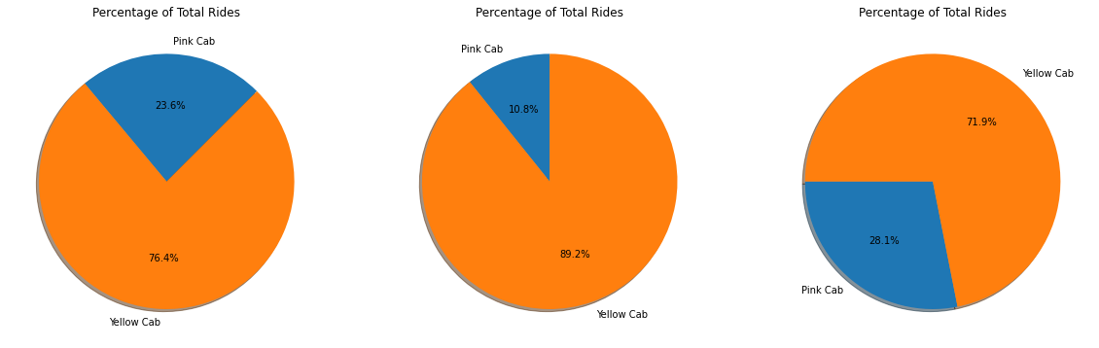
Profit Analysis

Slide 6
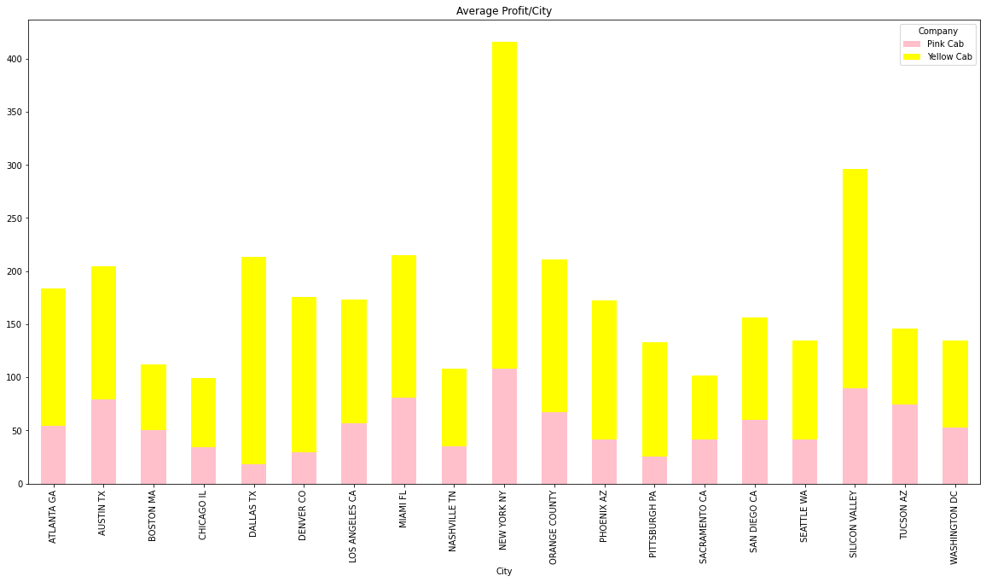
City Profit Analysis
The chart shows a significant difference in profit between the two company. The Yellow cab recorded the highest profit average in New York City and Silicon Valley

Slide 7
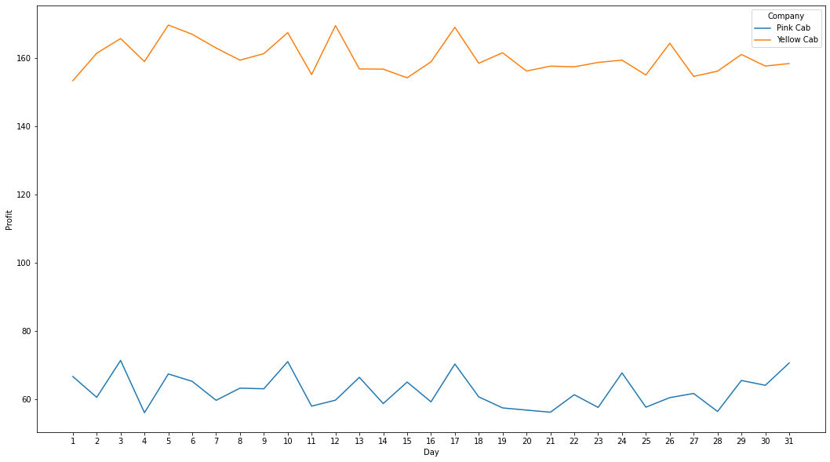
Daily Profit Analysis
The chart shows a significant difference between the two company, with Yellow Cab coming out tops of the company.

Slide 8
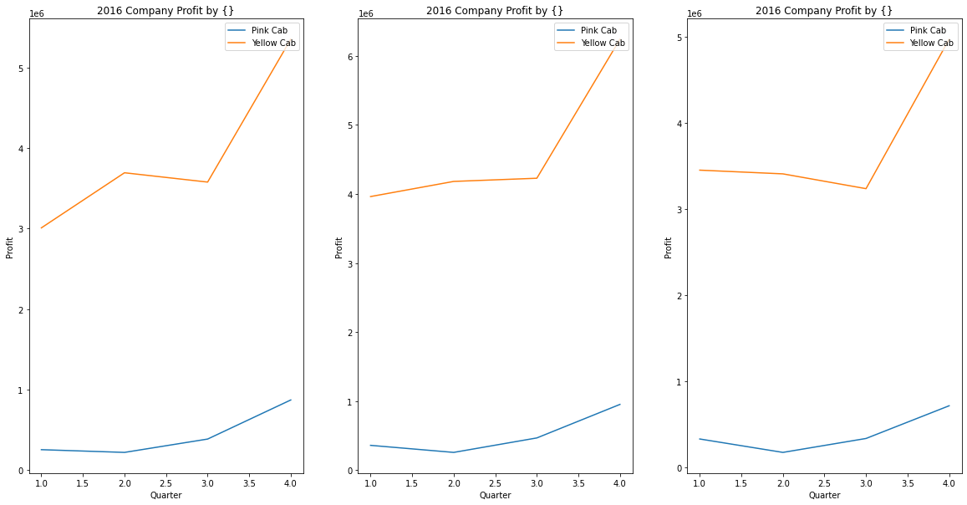
Quarterly Profit Analysis
The chart shows a significant difference in profit between the two companies, the chart shows that both companies record highest profit during the last quarter of the year.

Slide 9
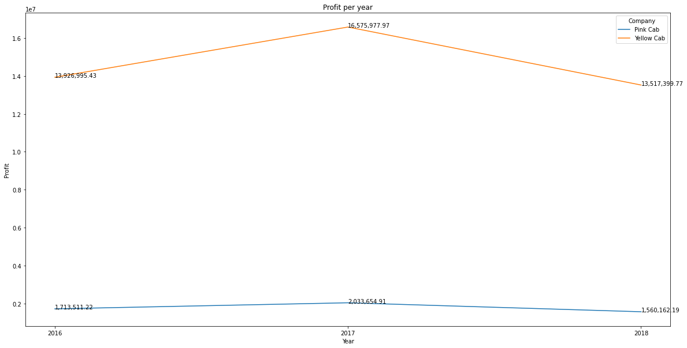
Yearly Profit Analysis
The chart shows a significant difference in the profit margin between Yellow cab and Pink Cab. The two companies recorded their highest profit in 2017.

Slide 10
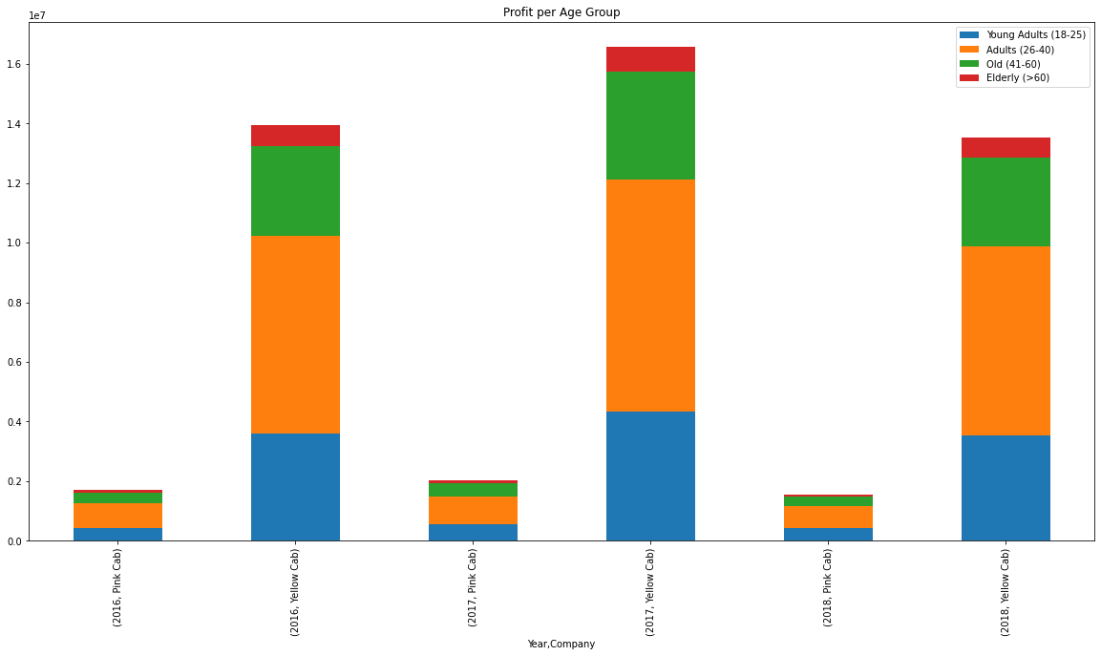
Age Category Profit Analysis
The chart shows that majority of the profit generated by both companies are mostly from customers within the age of 26-40 years, followed by the 41-60 age category.

Slide 11
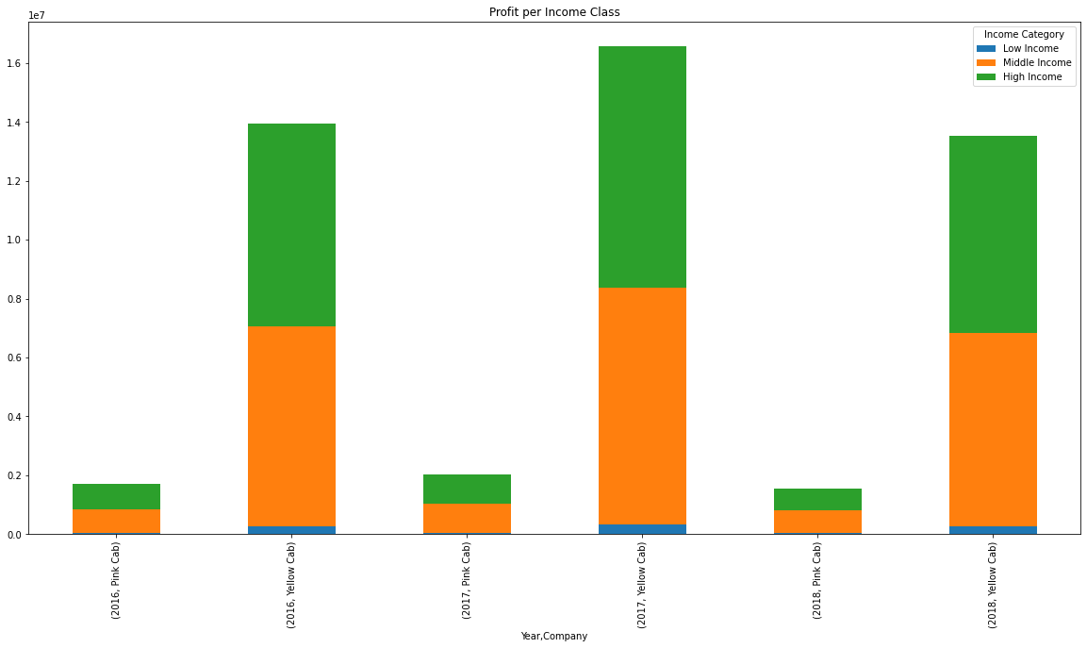
Income Category Profit Analysis
The chart shows that majority of the profit generated by both companies are mostly from Middle and High income customers.

Slide 12
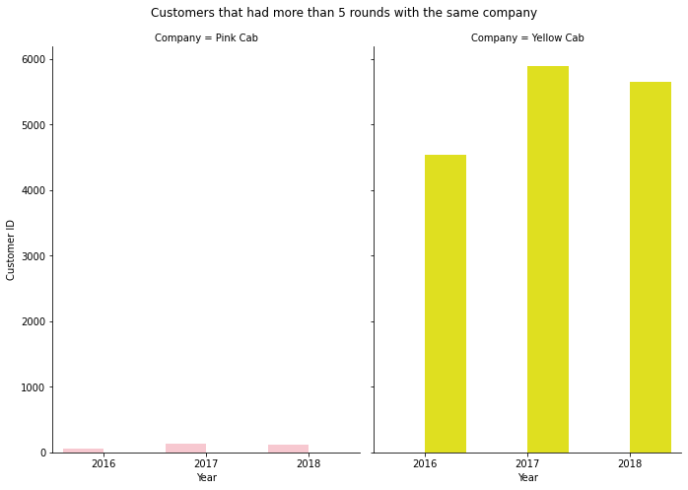
Customer Retention Analysis
The chart shows a huge disparity between the two companies. The yellow cab has a higher retention margin than pink cab does.

Slide 13
Summary/ Conclusion
Customer Base : Yellow cab has higher customer base in general across the US cities when compared to pink cab.
Customer Retention Percentage: there are increasing trend in the percentage of customers retainability of the two companies. However, yellow company had a higher percentage (almost two times that of pink cab company).
Age segment analysis: Both yellow and pink cab company showed similar trend in the age segments, with most of their customers falling between the ages of 26 and 40.
Profit analysis: Yellow cab company compared to pink has a larger percentage of total rides, percentage of total profit, and profit per ride.
Average Profit per KM: Yellow cab’s average profit per KM is almost 3x times the average profit per KM of the Pink cab.
Income-based Reach: Yellow Cab Company generally reaches consumers from all income brackets, albeit at a lower rate than Pink Cab Company, which isn't the most popular option for lower income class.
Based of the derived insights above, Yellow cab will be a good choice for investment.

Slide 14
Analysis done and Presented by Olutayo Benson-Oladeinbo
Thank You

